Slide 1
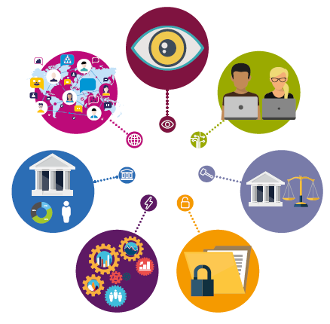
Distributed ledger technology in securities payment, clearing and settlement
BRA Day
Berlin, 13.07.2018
Olha Kravchenko

Slide 3
Topic and problem description:
CCPs play a MAIN role in managing risk, in increasing standardization and transparency of financial markets
DLT can provide a platform where CCPs, clearing members and qualified investors all interact with each other.
DLT allows the greater transparency and resilience, facilitates operational and capital cost improvements, and could lead to systemic risk reductions.
DLT can be an opportunity for CCP’s to improve their management standards.
CCPs - Central clearing counterparties
DLT - Distributed ledger technology

Slide 4
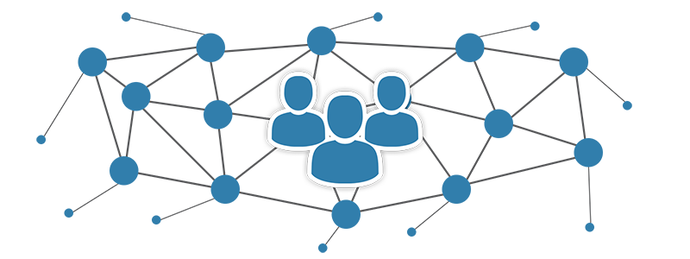
Possible benefits of Distributed Ledger Technology for securities markets:
speed the clearing and settlement
reduce counterparty risk
high level of availability
general reduction of costs
help render the processing of corporate actions through the use of smart contracts.

Slide 5
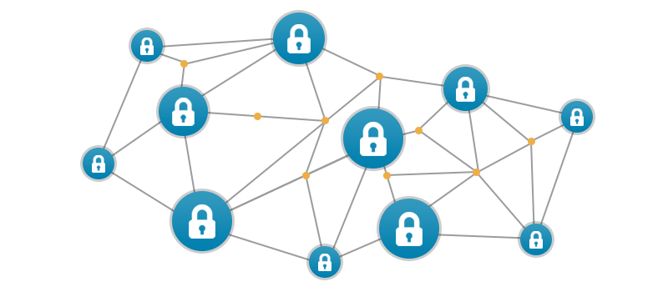
Key issues and possible risks
software can have 'bugs'
need for common technical standards and business rules
a balance between the public nature of the information and the need for anonymity or privacy
migration to the new distributed ledger environment carries risks
hacking of one network may jeopardise the security of many others

Slide 6
Main challnges and questions:
DLT and regulatory and compliance process (ISDA, MIFIDII, EMIR, ALM)
DLT implementation and release process
Licenzing and managing costs of the DLT

Slide 7
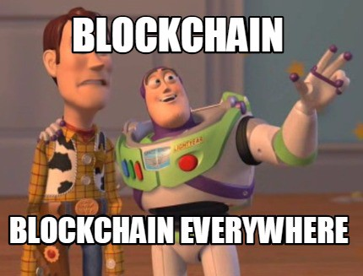
Thank you for attention!
Questions?

