Slide 1
GDPR meets the Blockchain
Presentation of Master’s Thesis
Nathan Vandy (Masters’ student at University of Maastricht)

Slide 2
Get to know me
Who are you?
Which topic are you working on?
Which problem do you solve?
What are your initial insights/findings?
How far are you in your research project?
What are the main challenges or questions that keep you up at night?
How can the BRA community help you?

Slide 3
Overview
The increase in volume and dissemination of data can produce clear societal benefits including greater accuracy, efficiency, and responsibility in of data-driven decisions. However, if not used correctly, it can produce unethical results (que buzzword Cambridge Analytica and Facebook social experiments).
Regulation of data use through the GDPR is definitely a positive step in the right direction. With the European market being one of the largest for data assimilation, the rights and obligations enshrined in the GDPR will create a higher level of data privacy and transparency for users, globally.
These concepts of privacy and transparency are also found in the technology of blockchain. Through it’s decentralised network that allows all nodes to have the script and therefore know the transaction occurring in the system and through encryption it has high privacy.
However, there are certain provisions of the GDPR that make it difficult for blockchain to be legally compliant.

Slide 4
GDPR Rights and Obligations
Objective
Understanding of the current state of legal rights afforded to data users
Understanding the legal obligations of the data controllers/processors
Method
Analysing the GDPR
Comparing the data privacy laws in the EU

Slide 5
Blockchain’s solutions and obstacles to GDPR compliance
Objective
Understanding of the current state blockchain technologies
Understand the future possibilities in the technology
Method
Read articles/thesis’
Speak to computer scientists

Slide 6
An assessment of a blockchain startup application
Objective
Determination of whether a blockchain is GDPR compliant
Method
Analysing the core functions of the blockchain application with a focus on automatic-decision making

Slide 7
Obstacles and Solutions
The word limit of the thesis is 10,000 words which is not enough to analyse the entirety of GDPR provisions in relation to blockchain. In order to circumvent this issue, I focused on the core substance of the GDPR - being the rights and obligations.
Coming from a legal background, understanding the functions of the technology in order to assess it’s legality proved difficult - the more discussions with computer scientists that I have, the clearer it becomes.

Slide 8
Closing Remarks
The future development of blockchain’s existence in the regulatory landscape is burdened by many different legal uncertainties. Whether it’s the classification of crytopcurrenices as a security or a commodity, the legal determination of who will be classified as the processor or the controller or the assessment of the privacy data also the data privacy issue.
The blockchain technology does not live in a vacuum. At the end of the day, the regulation doesn’t just affect the social utility of these token by making certain blockchain illegal, the lack of regulatory certainty also creates negative and volitile economic implications which contributes to the slow adoption of cryptocurrency’s mainstream userability.
We have already seen certain institutions moving towards creating collaborative relationships between this de-institutionalised eco-system i.e. Unitled INC/NEMO and Deutsche Bank. As time progresses, it will be necessary for more of these relationships to flourish, and for the ecosystem to be given more legal clarity.

Slide 9
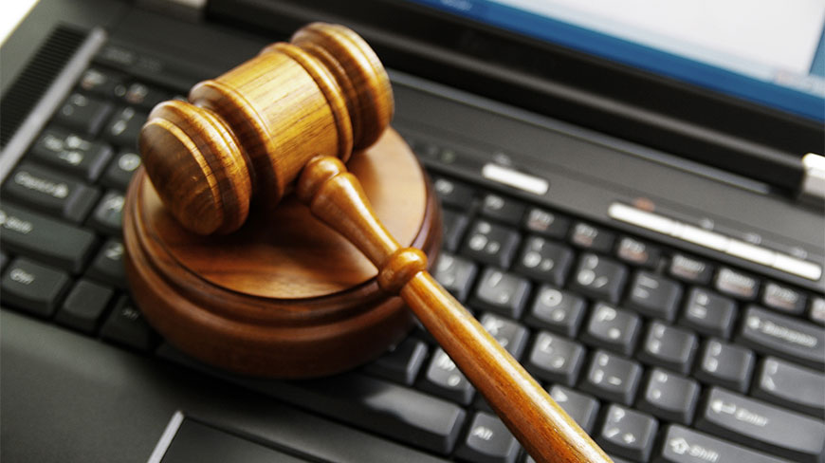
Thank you!
I am open for feedback and constructive criticism.

