Slide 1
VALUATION OF CRYPTO ASSETS – A CONCEPTUAL FRAMEWORK AND CASE APPLICATION
Presentation of the research approach
Karim Ajouaou Saidi
13th July 2018

Slide 2
Outline
Introduction to the topic
Research approach
Key findings

Slide 3
Introduction to the topic
Definition of the topic:
Valuation of crypto assets: A conceptual framework and case application
Crypto assets: digital assets recorded on a distributed ledger (blockchain), 4 types: Crypto-currencies, utility tokens, security tokens, asset backed tokens
Valuation: Determining the fundamental value of an asset

Slide 4
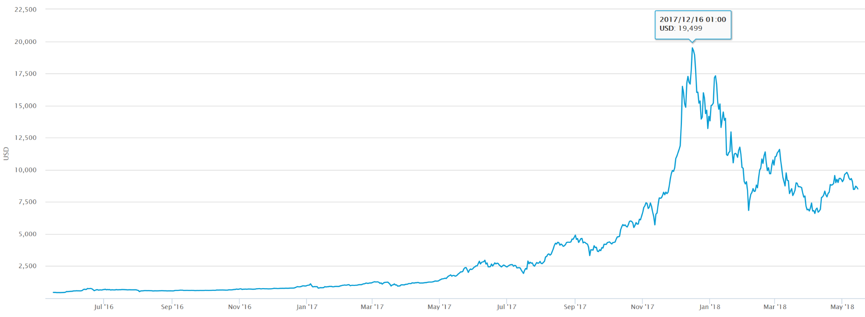
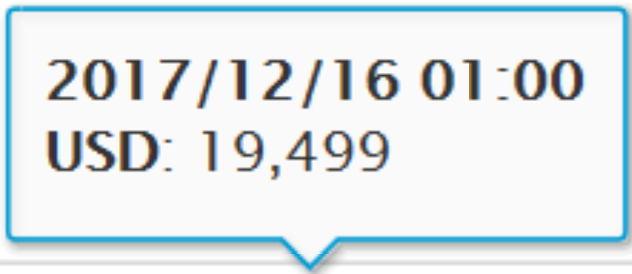
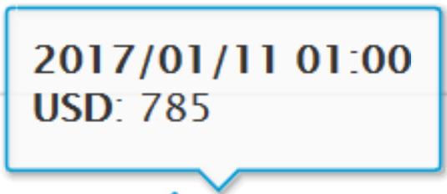
Introduction to the topic
Motivation:
Bitcoin price July 2016 – May 2018 (source: blockchain.info)
Do these price fluctuations really reflect the value?

Slide 5
Research approach
Research questions:
How can we determine the fundamental value of crypto assets?
What valuation techniques can be applied to the different token classes?
Based on the models: What is the fundamental value of IOTA token?
Methodology (research approach):
Theoretical part: collect and evaluate all current valuation methods for crypto assets
further development, limitations, applicable to which tokens?
Practical part:
Valuation of IOTA based on Equation of Exchange

Slide 6
Findings – Valuation techniques
Valuation model | sees crypto assets as… | applicable to…
Traditional DCF and CAPM | Investment/ asset | Tokens with fixed returns (security tokens, staking tokens…)
Asset rotation theory | Investment/ asset | All tokens
Equation of Exchange (MV=PQ) | Means of payment (currency) | Crypto currencies, utility tokens
NVT ratio | Network | All network tokens (crypto currencies, some utility tokens)
Metcalfe’s Law | Network | All network tokens (crypto currencies, some utility tokens)
Cost of production approach | Product, commodity | Mineable tokens with production costs
Accessibility discount | Tradable Investment | All tradable tokens

Slide 7
Findings – Application to the IOTA token
Valuation based on the Equation of Exchange (MV = PQ):
Based on estimation of future market (top down analysis)
Main target areas of IOTA:
IoT: Industrial IoT, smart cities, smart homes, connected health, connected cars
Financial: E-commerce, P2P-payments
Estimating market volume of these business areas and IOTA market share (PQ)
Estimation of the future velocity (V)
Calculate future market cap (M)
Discount future utility value to the present
IOTA is a DLT designed for the machine economy (IoT) using ‘the Tangle’ instead of a blockchain:
no transactions fees, better scalability

Slide 8
#thankyou

