Slide 1
Establishing a Blockchain Innovation Index from a Technological Innovation Perspective
Daniel Berwik – London, England
Nika London – Berlin/Frankfurt, Germany
Organizational Innovation & Entrepreneurship
Copenhagen Business School
Master Thesis – (120 - 160p)
Deadline: 17.09.

Slide 2
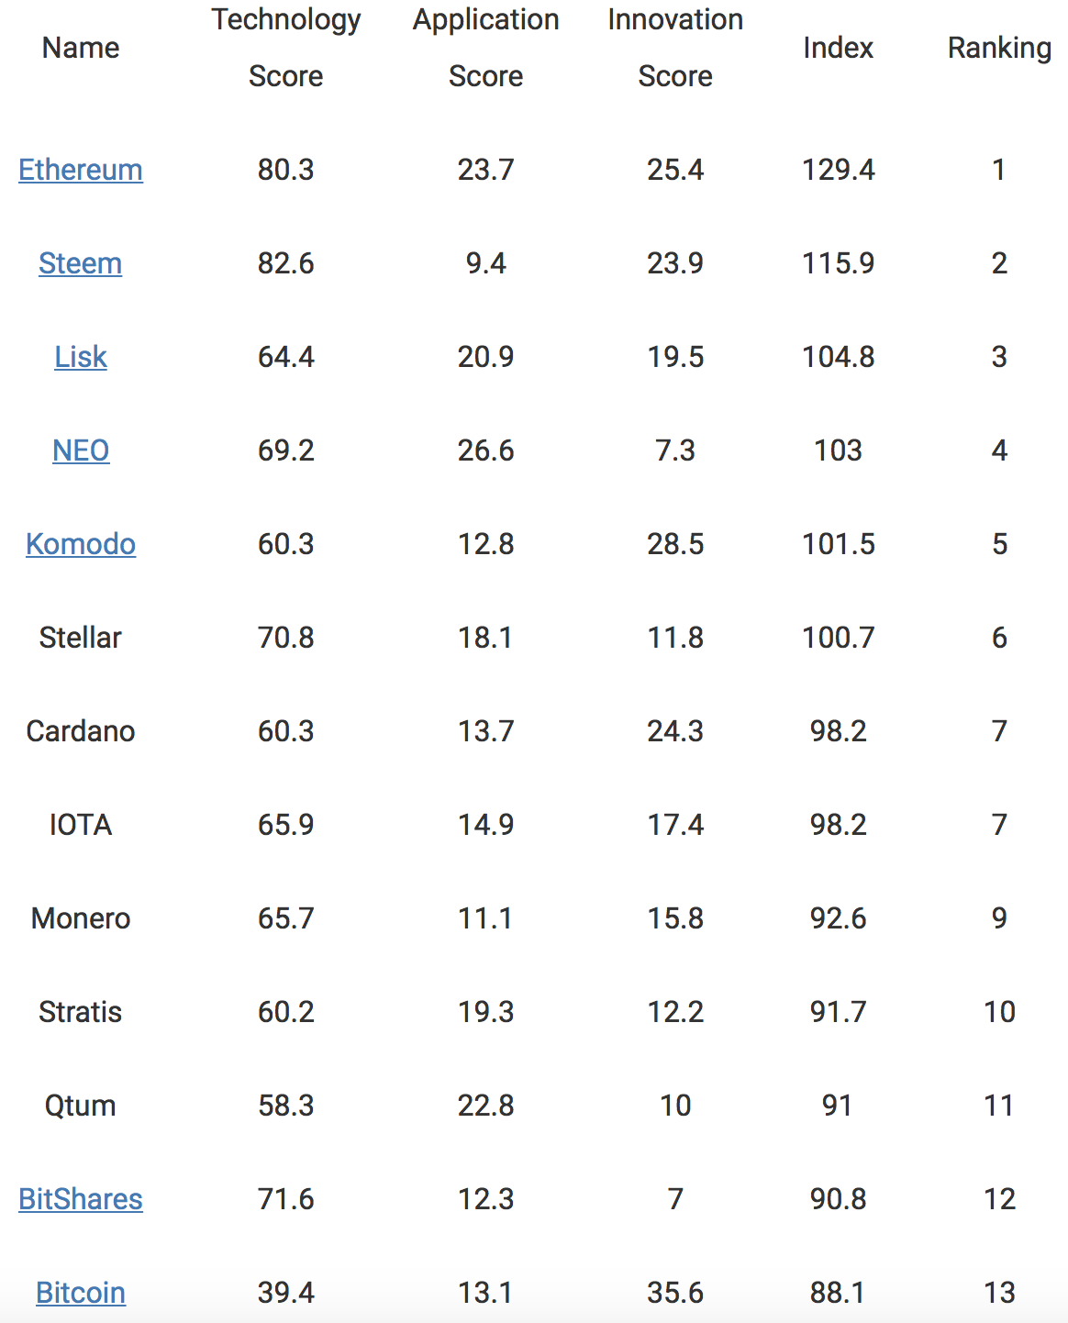
Problem
By CCID - Research Institute of China as of Mai 2018
  28 DLT listed
No transparency about the rationale of scores
Questionable criteria

Slide 3
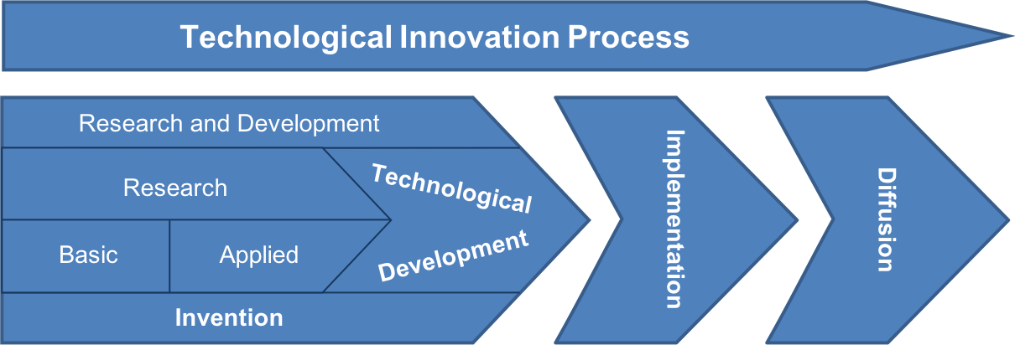
School of Technological Innovation
(adapted from Diaconu, 2011)
Frascati Manual
Oslo Manual

Slide 4
Criteria & Data
Deductive Approach
Criteria | R&D Activity | Implementation Activity | Diffusion Activitiy
Inductive Approach
Data | Bitcoin DLT | Ethereum DLT | NEM DLT | IOTA DLT
Why | First DLT | Community backed | Industry backed | Paradigm change

Slide 5
Gains & Pains
Gains
Pains
Allows benchmarking amongst DLT providers
Allows KPI‘s → increase in productivity
Decrease burden for organizations to adopt DLT
  Increases diffusion rate
Provides insights about key innovation sources and its relation to economic wealth
Inductive approach might not be realizable, due to scope
Finding significant deductive data for DLT‘s
Fast pace industry could outdate findings, rapidly

Slide 6
Technological Innovation Process
Research and Development
Implementation
Diffusion
Research
Technological
Basic
Applied
Development
Invention

